Slide 1
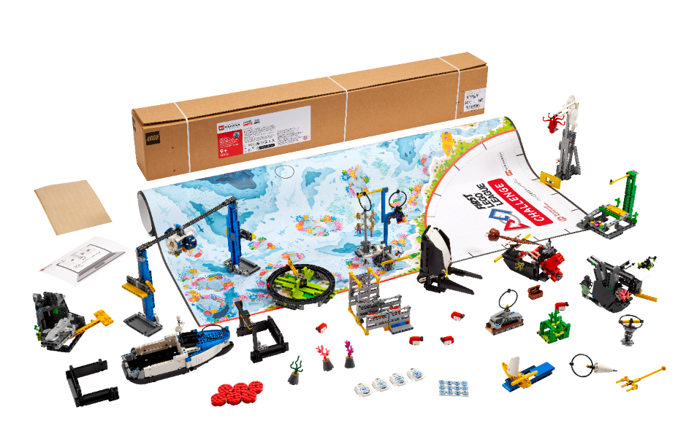


Session 9
Solution Planning
Notes:
Facilitator Tips –
The team will use their art piece and pedestal in Mission 04 of the robot game.
The team can also have a backup of their programs on external drive like a USB stick or an online storage website.
Have a clear strategy for which programs to run and in what order during the robot game.
The Share tasks are important to keep the whole team updated on how the project and the robot are developing.
Provide the team with the Core Values rubric.

Slide 2
Session Overview
Outcomes
The team will code their robot to deliver their Innovation Project model and solve missions.
The team will iterate and improve their Innovation Project solution based on testing and feedback.
Notes:
Facilitator Tips –
Examples recorded here could be used for the innovation project presentation or robot design explanation.
The team should have a clear strategy for which programs to run and in what order during the robot game.
The team can also have a backup of their programs on external drive like a USB stick or an online storage website.
The Share tasks are important to keep the whole team updated on how the project and the robot are developing.
Core Values are evaluated throughout the judging session while teams present on their innovation project and robot design. Review the judging rubrics with the team.

Slide 3
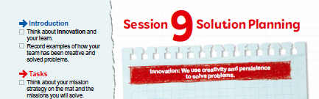


Introduction
Think about innovation and your team.
Record examples of how your team has been creative and solved problems.
Notes:
Introduction (10-15 minutes)
Facilitator Tips –
Examples recorded here could be used for the innovation project presentation or robot design explanation.
The team should have a clear strategy for which programs to run and in what order during the robot game.
The team can also have a backup of their programs on external drive like a USB stick or an online storage website.
The Share tasks are important to keep the whole team updated on how the project and the robot are developing.
Core Values are evaluated throughout the judging session while teams present on their innovation project and robot design. Review the judging rubrics with the team.

Slide 4
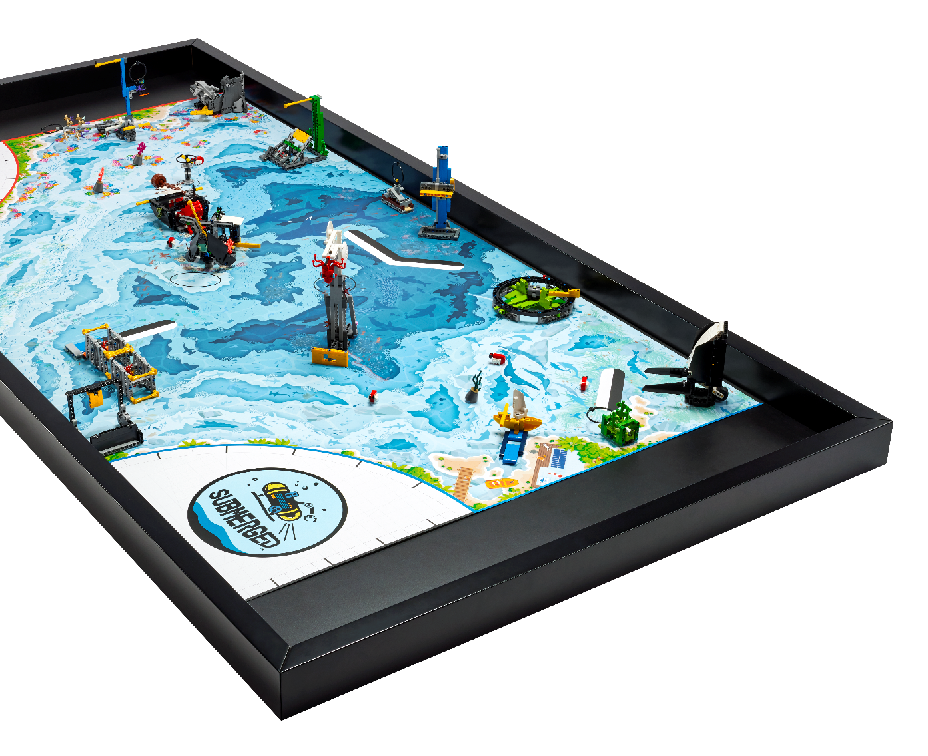
Iterate and Improve Robot Solution
Think about your mission strategy on the mat and the missions you will solve.
Continue to create a solution for each mission as time allows.
Notes:
Team Tasks (100-120 minutes)
Facilitator Tips –
Examples recorded here could be used for the innovation project presentation or robot design explanation.
The team should have a clear strategy for which programs to run and in what order during the robot game.
The team can also have a backup of their programs on external drive like a USB stick or an online storage website.
The Share tasks are important to keep the whole team updated on how the project and the robot are developing.
Core Values are evaluated throughout the judging session while teams present on their innovation project and robot design. Review the judging rubrics with the team.

Slide 5


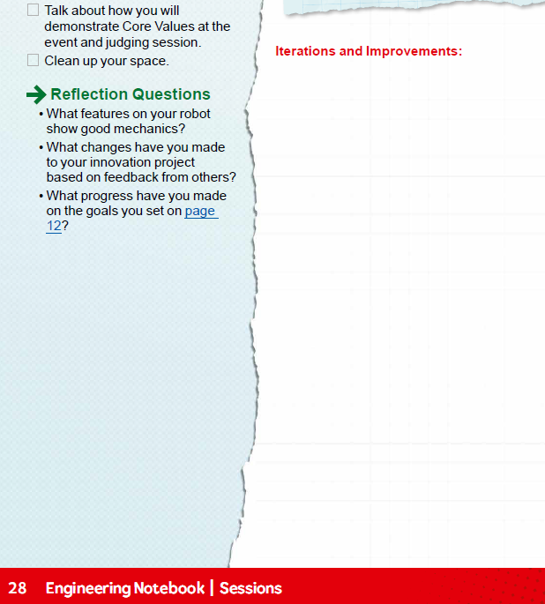

Iterate and Improve Robot Solution
Test, iterate, and improve your robot and Innovation Project solutions. Be sure to document all this.
Notes:
Team Tasks (100-120 minutes)
Facilitator Tips –
Examples recorded here could be used for the innovation project presentation or robot design explanation.
The team should have a clear strategy for which programs to run and in what order during the robot game.
The team can also have a backup of their programs on external drive like a USB stick or an online storage website.
The Share tasks are important to keep the whole team updated on how the project and the robot are developing.
Core Values are evaluated throughout the judging session while teams present on their innovation project and robot design. Review the judging rubrics with the team.

Slide 6

Share
Get together at the mat.
Show the work completed on the innovation project and robot game.
Talk about how you will demonstrate Core Values at the event and judging session.
Clean up your space.
Notes:
Share (10-15 minutes)
Get together at the mat.
Show the work completed on the innovation project and robot game.
Talk about how you will demonstrate Core Values at the event and judging session.
Clean up your space.

Slide 7

Reflection Questions
What features on your robot show good mechanics?
What changes have you made to your innovation project based on feedback from others?
What progress have you made on the goals you set on page 12?
Notes:
Team Tasks (100-120 minutes)
Facilitator Tips –
Examples recorded here could be used for the innovation project presentation or robot design explanation.
The team should have a clear strategy for which programs to run and in what order during the robot game.
The team can also have a backup of their programs on external drive like a USB stick or an online storage website.
The Share tasks are important to keep the whole team updated on how the project and the robot are developing.
Core Values are evaluated throughout the judging session while teams present on their innovation project and robot design. Review the judging rubrics with the team.

Slide 8

Multimedia Resources
You may wish to embed a relevant, age-appropriate video for your students here.
Notes:
Choose a relevant, age-appropriate video for your students.

Slide 9

Clean Up
Notes:
Allow time for cleanup and place any unfinished models and their pieces in a sealed plastic bag.
Clean Up Pointers
You may wish to play a video or song during clean up time Link on
GoNoodle: https://family.gonoodle.com/activities/clean-up
Link on YouTube Kids: https://www.youtubekids.com/watch?v=ZJFk87ZsHn0
Link on Youtube: https://youtu.be/ZJFk87ZsHn0

Slide 10


LEGO, the LEGO logo, the SPIKE logo, MINDSTORMS and the MINDSTORMS logo are trademarks of the/sont des marques de commerce du/son marcas registradas de LEGO Group. ©2024 The LEGO Group. All rights reserved/Tous droits réservés/Todos los derechos reservados. FIRST ®, the FIRST ® logo, Coopertition ®, Gracious Professionalism®, and FIRST® DIVESM are trademarks of For Inspiration and Recognition of Science and Technology (FIRST). LEGO® is a registered trademark of the LEGO Group. FIRST® LEGO® League and SUBMERGEDSM are jointly held trademarks of FIRST and the LEGO Group. All other trademarks are the property of their respective owners. ©2024 FIRST and the LEGO Group. All rights reserved.

